Slide 1


How We Adopted Secure Software Delivery Practices for Fission OSS Serverless Platform
Sanket Sudake
8th Feb, 2025

Slide 2

About Me
Principal Engineer, InfraCloud
Maintainer Fission - Serverless
Interest Areas: Cloud/Containers, Distributed Systems
Past: Started as Kernel Engineer
Worked as Go developer, Openstack developer, SRE
Loves tinkering around Opensource projects
@sanketsudake
Notes:
About Me
Principal Engineer, InfraCloud
Maintainer Fission - Serverless
Interest Areas: Cloud/Containers, Distributed Systems
Past: Started as Kernel Engineer
Worked as Go developer, Openstack developer, SRE
Loves tinker around Opensource projects

Slide 3
About Fission
Kubernetes Native Faas
Any public cloud or on-prem
Cloud-native platform with K8s base
Wide Community Adoption
8k+ Stars, 20+ Enterprise Users
2000+ Monthly Installs
K8s deployments with 200+ nodes
Fast and Flexible
100ms cold start with warm pool
Easily Customizable and extensible
Support different languages and strategies
Languages & Integrations
Trigger: HTTP, MQ, Time triggers
Support all most of popular languages
Observability, Tracing support
Notes:
Fission is a kubernetes -native serverless platform. It can on CNCF compliant Kubernetes anywhere.
Kubernetes Native Faas
Any public cloud or on-prem
Cloud-native platform with K8s base
Wide Community Adoption
8k+ Stars, 20+ Enterprise Users
2000+ Monthly Installs
K8s deployments with 200+ nodes
Fast and Flexible
100ms cold start with warm pool
Easily Customizable and extensible
Support different languages and strategies
Languages & Integrations
Trigger: HTTP, MQ, Time triggers
Support all most of popular languages
Observability, Tracing support

Slide 4




















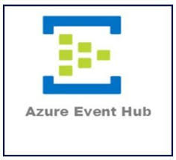


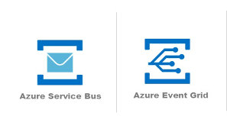
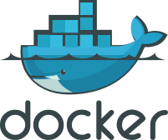







Fission Landscape
HTTP
Cron
MQ
Notes:
Fission provides support different languages like java, python, go, javascript etc.
Developers write functions and deploy them on Fission.
Fission also build source code .
Once function is deployed it can be triggered via trigger like HTTP, Message Queue, Timer.
We have build integrations with message queues like Kafka, SQS, RabbitMQ, Redis etc.

Slide 5
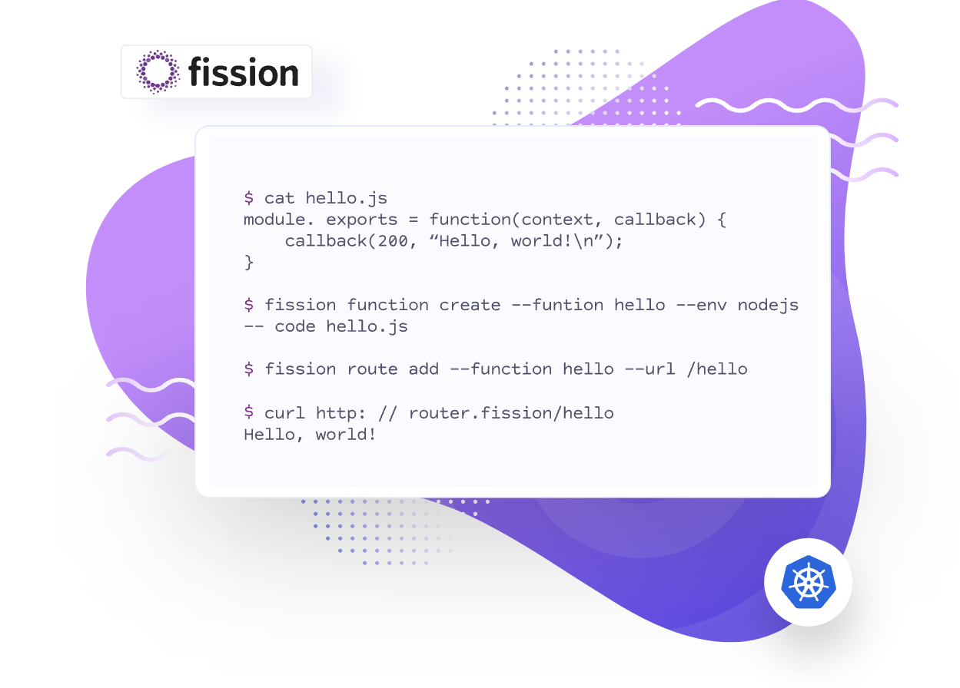
Notes:
Source https://fission.io/images/body-img-1.svg
Here is the example of simple Hello world around Fission.
We create a simple function which follows javascript specification by fission.
Most of functions just accept request payload and return response. Rest of things are handled by fission.
Once function is created, we create a http route which handles all calls to the function.

Slide 6
SSDF strategy by NIST
Prepare Organization
Ensuring process, people, technology are ready
Continuous adoption of secure software development
Produce Well-Secured Software
Software with minimum vulnerabilities
Less target attack surfaces
Protect Software
Safeguarding software from software tampering and unauthorized Access
Respond to Vulnerabilities
Identify vulns and address quickly
Prevent similar instances in future
Notes:
Average cost of a software supply chain attack: US$4.63 million
Average time to identify and contain a software supply chain attack: 294 days
Share of data breaches originating from software supply chain attacks in 2023: 12%
Annual increase in software supply chain attacks over the past 3 years: 742% 2
SSDF strategy by NIST
National institute of standards and technology
Prepare Organization
Ensuring process, people, technology are ready
Continuous adoption of secure software development
Produce Well-Secured Software
Software with minimum vulnerabilities
Less target attack surfaces
Protect Software
Safeguarding software from software tampering and unauthorized Access
Respond to Vulnerabilities
Identify vulns and address quickly
Prevent similar instances in future

Slide 7
Standards in Consideration
OpenSSF Scorecard
Evaluate project security Risks
Actionable insights for security posture
SLSA Guidelines
Ensure Secure Software Supply Chain
Targets end-to-end build integrity
CII Best Practices
Encourage community driven improvements
Focuses project quality standards
Github Open Source Guides
Offers resources for maintainers
Integrated solutions across GH platform
Notes:
OpenSSF Scorecard
Evaluate project security Risks
Actionable insights for security posture
CII Best Practices (Core Infrastructure Initiative)
Encourage community driven improvements
Focuses on project quality standards
SLSA Guidelines
Ensure secure software supply chain
Target end-to-end build integrity
Github Open Source Guides
Offers resources from maintainers
Integrated solution across GH platform
There has been a lot of discussion about the need for “ingredient labels” for software—a “software bill of materials” (SBOM) that tells users what is in their software. Building off this analogy, SLSA can be thought of as all the food safety handling guidelines that make an ingredient list credible. From standards for clean factory environments so contaminants aren’t introduced in packaging plants, to the requirement for tamper-proof seals on lids that ensure nobody changes the contents of items sitting on grocery store shelves, the entire food safety framework ensures that consumers can trust that the ingredient list matches what’s actually in the package they buy.
Likewise, the SLSA framework provides this trust with guidelines and tamper-resistant evidence for securing each step of the software production process. That means you know not only that nothing unexpected was added to the software product, but also that the ingredient label itself wasn’t tampered with and accurately reflects the software contents. In this way, SLSA helps protect against the risk of:
Code modification (by adding a tamper-evident “seal” to code after source control)
Uploaded artifacts that were not built by the expected CI/CD platform (by marking artifacts with a factory “stamp” that shows which build platform created it)
Threats against the build platform (by providing “manufacturing facility” best practices for build platform services)

Slide 8
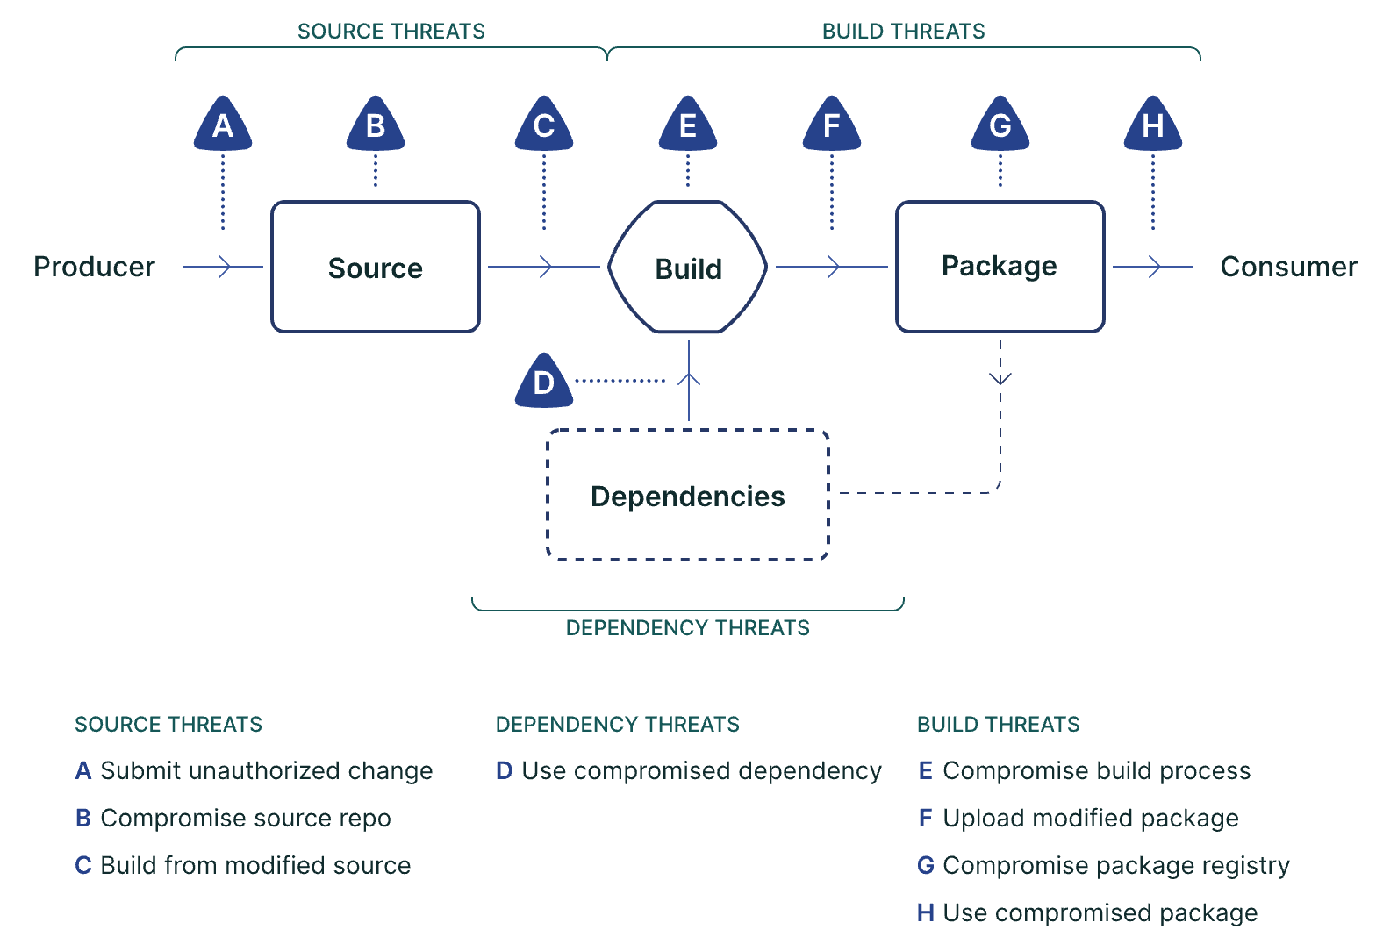
SLSA Threats
Source: slsa.dev
Notes:
https://slsa.dev/spec/v1.0/images/supply-chain-threats.svg SLSA Threats
SLSA defined different threats possible at source, build, package and dependencies level.
Source
Submit unauthorized change
Compromised source repo
Build from modified source
Depencies
Compromised or vulnerable dependencies
Build threats
Compromise build process
Upload modified package
Compromise package registry
Use compromised package

Slide 9
Fission Sources
Go
Dockerfile
Helm Templates
Github Workflows
Go Modules
Build Tools
External Github Actions
Container Base Images
Fission CLI
Container Images
Fission CLI
Helm Charts
Environment Runtimes
Sources
Dependencies
Artifacts
Notes:
Lets understand quickly what all things we have in fission in terms of
Sources, dependencies and artifacts for target attacks.
Sources
Dockerfile
Helm Templates
Github workflows
Dependencies
Build tools
External Github actions
Cotnainer Base images
Artifacts
Container images Around 7-8 iamges
Helm charts
Environments Runtimes -
Fission CLI
Now we have understood our fission source mappings, we wil go through how we accept changes.

Slide 10
Source - Life of PR
Lint & Unit Test
Code Coverage
OpenSSF Scorecard Scans
2
Trusted Contributor & Ensure Signed Commits
6
CI Tests
Upgrade Tests
Reviews
1
2
3
Fission
4
CodeQL
Dependency &
Secrets Scan
2
Approved
5
Notes:
Source life of PR
Accept contributions wide variety of contributors. SOme of them are frequent and some of them new.
We request for signed commits
Once PR is made,
It goes through different CI jobs
Lint and unit
CI tests
Upgrade tests
For static code analysis we use codeql to identify if any new vulnerabilities are being introduced in the PR.
We also check for dependency and secret scans. Dependabot will inform if any dependencies with vulnerabilities are being introduced.
Once all checks are good reviews changes. Post merge openssf scorecard scans run, which identifies if any standards are not being followed.
We try to shift left as possible to avoid late findings.

Slide 11
Dependencies
Dependency Scans
Daily
Each PR
Dependency Pinning
CI Runs on Dependency Changes
Dependabot for keeping deps upto update
Ensure known vulnerabilities are fixed quickly
Go Modules
Github Actions
Container Base Images
Notes:
Dependency Scans
Weekly
Each PR
Dependency Pinning
CI Runs on Dependency Changes
Dependabot for keeping deps upto update
Ensure known vulnerabilities are fixed quickly

Slide 12
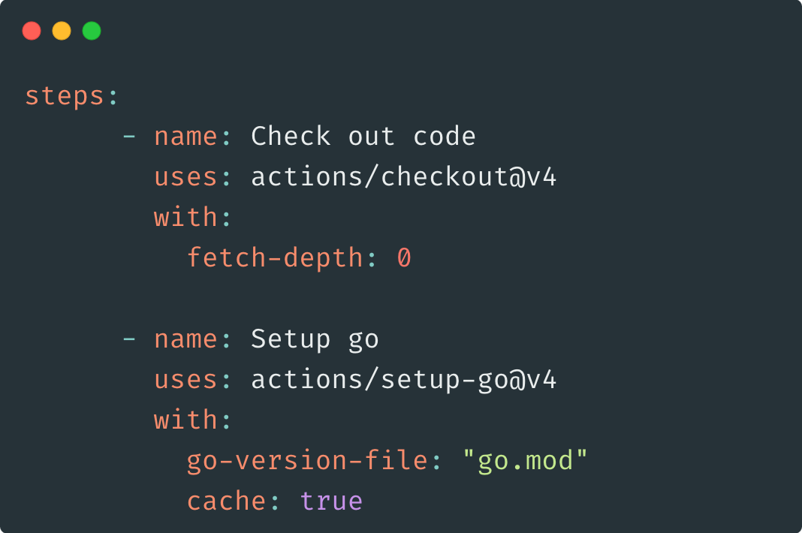
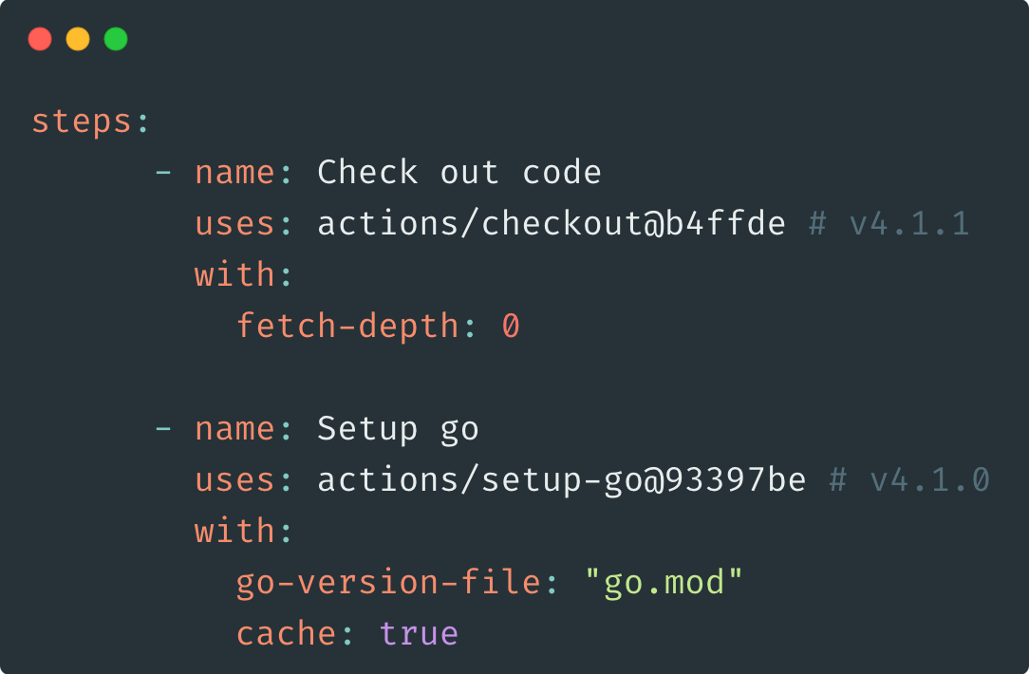
Dependencies
Earlier
Current
Github Action Pinned Dependencies
Notes:
Pining github action dependencies in actions
Earlier: steps:
- name: Check out code
uses: actions/checkout@v4
with:
fetch-depth: 0
- name: Setup go
uses: actions/setup-go@v4
with:
go-version-file: "go.mod"
cache: true Current: steps:
- name: Check out code
uses: actions/checkout@b4ffde # v4.1.1
with:
fetch-depth: 0
- name: Setup go
uses: actions/setup-go@93397be # v4.1.0
with:
go-version-file: "go.mod"
cache: true

Slide 13
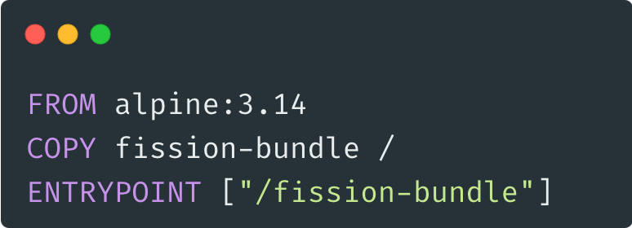
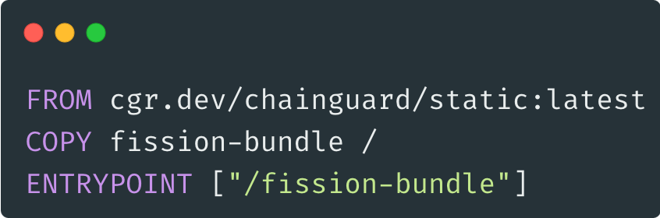
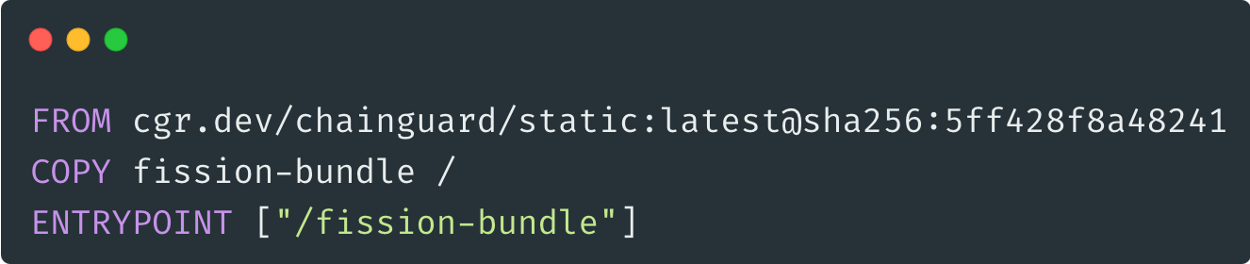
Container Base Image Pinned Dependencies
Notes:
Pinning docker images
To make builds are reproducible and ensure your builds
Earlier we used to alpine image to pack our fission Go binaries.
But we needed frequent updates as vulnerabilities

Slide 14
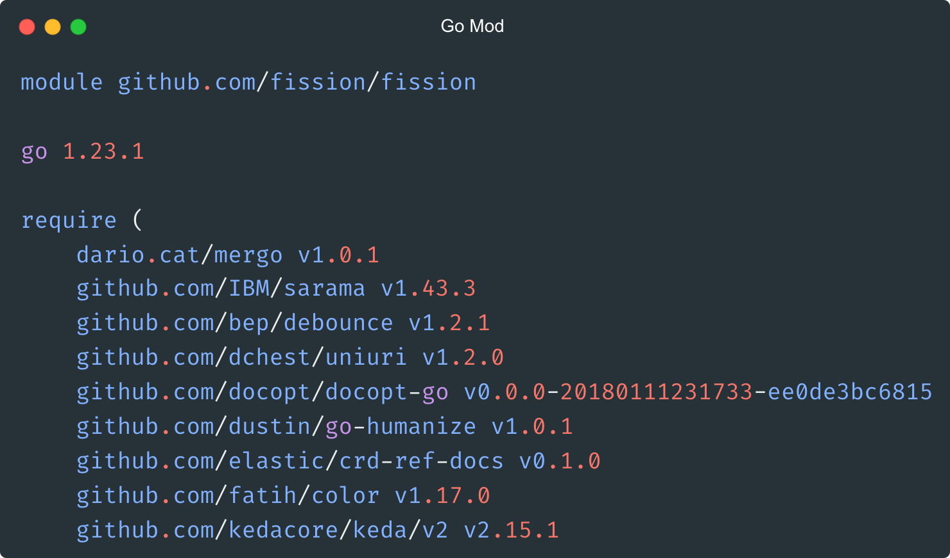
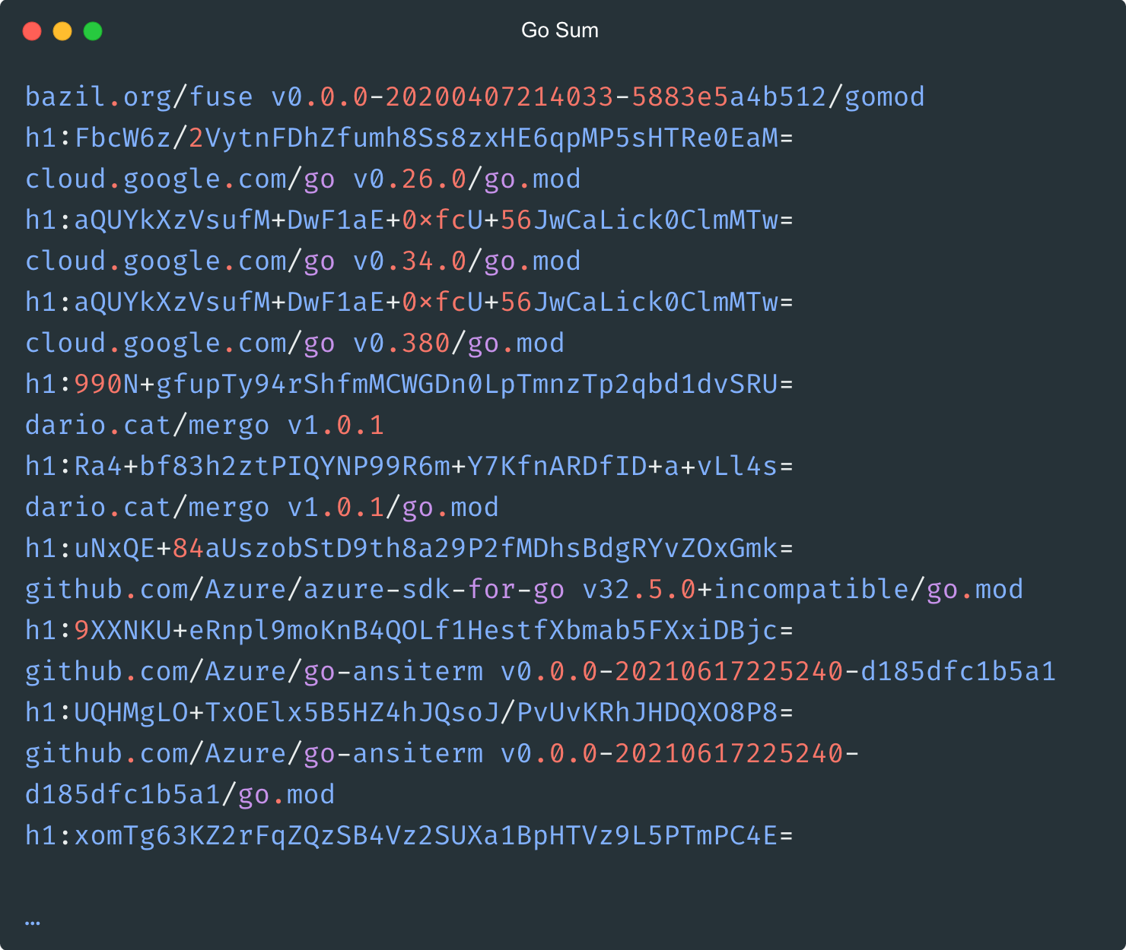
Go Modules Pinned Dependencies
Notes:
https://github.com/fission/fission/blob/main/go.mod
https://github.com/fission/fission/blob/main/go.sum
All Go dependences are managed via go modules it go.mod
Go builds are pretty much reproducible now, Thanks to go maintenance team in putting lot of efforts.
Go SBOM are also embedded in the Go binary. User can query all go modules info in the binary.

Slide 15
Release Workflow
Generate Go Binaries for Arch + OS
Sign Binaries With Cosign
SLSA Provenance
3
4
Git Tag
1
2
5
Generate Container Images
Sign Image with Cosign
Generate Changelog
3
5
6
Helm Manifests
Publish in Helm Repo
6
Publish Release Artifacts
Notes:
Release workflow
Whenever we are ready for release we create a git tag on repository with semantic versioning.
It triggers release workflow.
We use goreleaser to build binaries. There are some CLI and docker images.
For docker images, we build go binary first and just wrap them inside container images.
We use cosign to sign binaries as well as container images and manifests.
Post build all this process SLSA provenance is generated so that user can be verify build provenance at a later stage.
SLSA provenance briefs more how build was built and give a way to verify if build is valid or does it have any contamination.
We also supply helm charts use are used to deploy all fission services on kubernetes platform.
Tools used
Goreleaser to build binaries ford
Goreeaser to build cross platform docker images
Sign image with cosign
SLSA provenance Generator

Slide 16
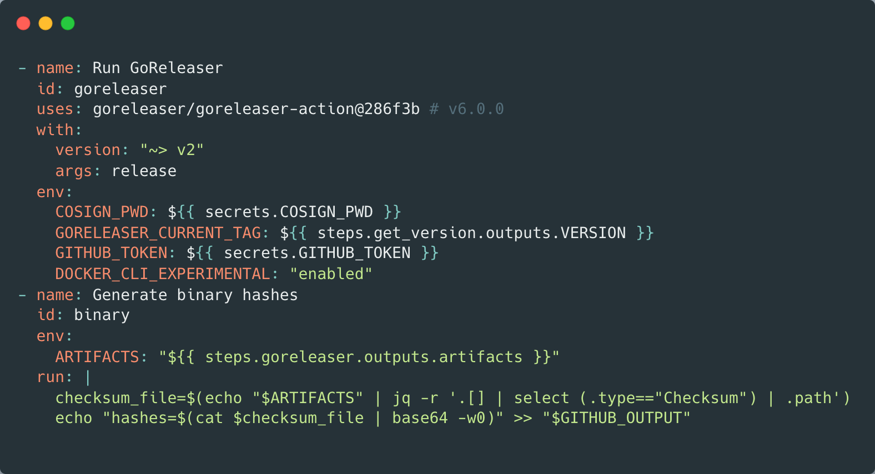
Generating Provenance for Binaries
Notes:
Generating provenance for binaries

Slide 17
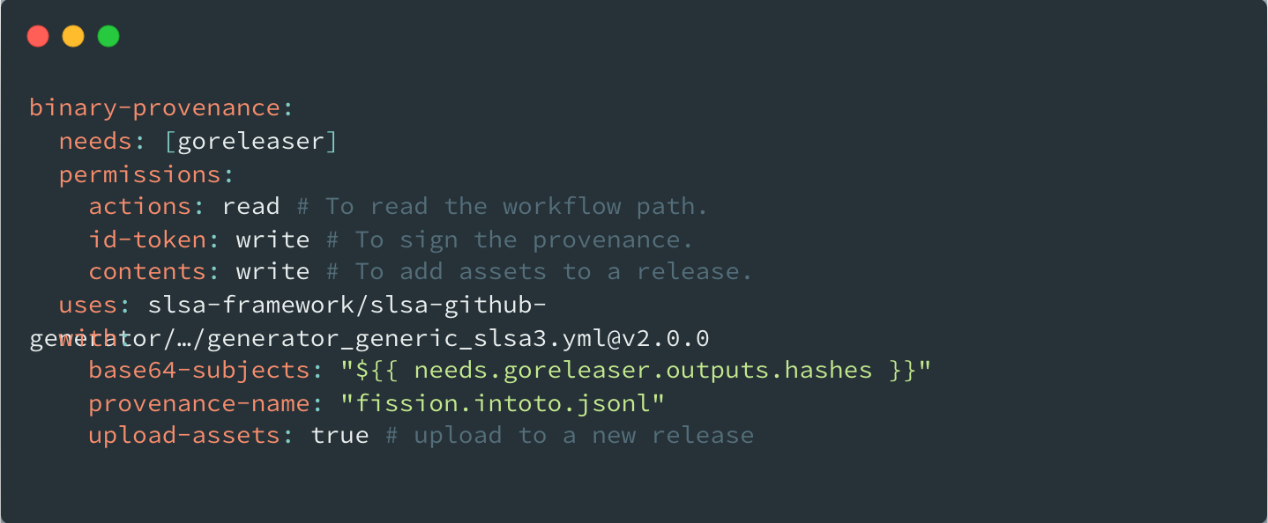
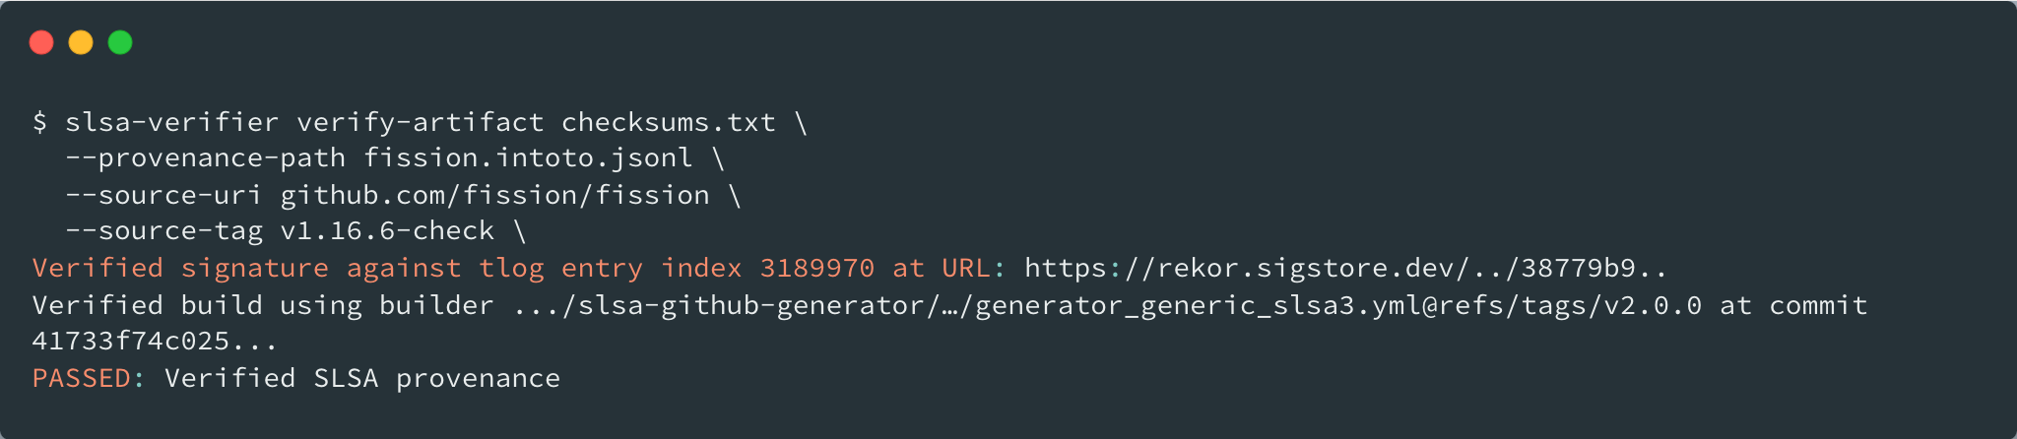
Provenance Generation & Verification
Notes:
Provenance Generation and Verification

Slide 18
Next Steps
CII Best Practices Gold Batch
SLSA L3 Level Completion
BOM visualization
Better Response on Known/Unknown Vulnerabilities
Improvements on OpenSSF score
Enable Fuzzing
Notes:
CII Best Practices Gold Batch
SLSA L3 Level Completion
Image Provenance
Better Response on Known/Unknown Vulnerabilities
Improvements on OpenSSF score
Enable Fuzzing

Slide 19
Thank You
Sanket Sudake
8th Feb, 2025

